Slide 1

Project Closeout and Termination
G.R. Labbé

Slide 2
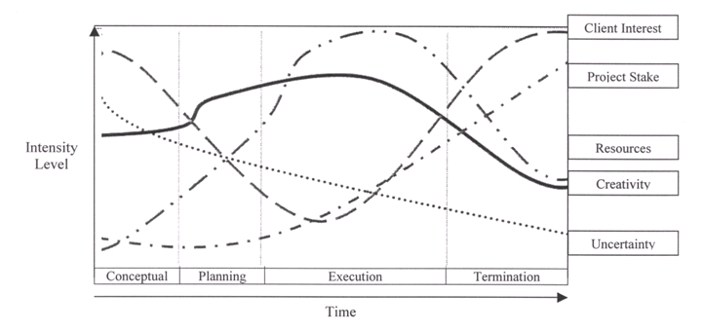
Introduction
One of the unique characteristics about a project is that they are created with a finite life. When we are planning the project, we are also planning for its extinction.

Slide 3
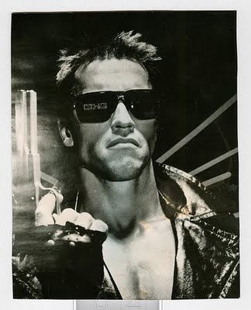

Project Termination
Project Termination is a process that provides for:
Acceptance of the project by the project's sponsor;
Completion of various project records;
Final revision and issue of documentation to reflect its final condition; and,
The retention of essential project documentation (Lessons Learned).

Slide 4
Types of Project Termination
Termination by Extinction
This process occurs when the project is stopped due to either its successful or unsuccessful conclusion.
The project's final budget is audited
Team members receive new work assignments
Any material assets the project employed are dispersed or transferred according to company or contractual terms

Slide 5
Types of Project Termination
Termination by Addition
This approach concludes a project by institutionalizing it as a formal part of the parent organization.
For example, suppose an automotive company has successfully introduced a new vehicle. The new cars are running down the new production line, the project team is then not disbanded, but changed into a support team for the running production.
The project has indeed been terminated, but its success has led to its addition to the organizational structure of the organization..

Slide 6
What is:
a Project?
a Process?
A project is a temporary and one-time endeavor.
A project is a sequence of unique, complex, and connected activities having one goal or purpose and it must be completed by a specific time, within budget, and according to defined specification.
A process is a permanent endeavor, designed to be repetitive, undertaken to create a unique product or service, which brings about beneficial change or added value.

Slide 7
Types of Project Termination
Termination by Integration.
Integration represents a common, but exceedingly complicated method for dealing with successful projects. The project's resources, including the project team, are reintegrated within the organization's existing structure following the conclusion of the project. Both in matrix and project organizations, personnel released from project assignments are reabsorbed within their functional departments to perform other duties or simply wait for new project assignments.
In many organizations, it is not uncommon to lose key organizational members at this point. They may have so relished the atmosphere and performance within the project team that the idea of reintegration within the old organization holds no appeal for them, and they leave the company for fresh project challenges.

Slide 8

Types of Project Termination
Termination by Starvation
This can happen for a number of reasons. There may be political reasons for keeping a project officially "on the books", even though the organization does not intend it to succeed or anticipates it will ever be finished.
The project may have a powerful sponsor who must be placated with the maintenance of his or her "pet project".

Slide 9
Types of Project Termination
Termination by Starvation
Another reason may be because of general budget cuts, an organization may keep a number of projects on file so that when the economic situation improves, they can be reactivated.
An argument can be made that termination by starvation is not an outright act of termination at all, but rather a willful form of neglect by slowly decreasing the project budget to the point where the project cannot possibly remain viable.

Slide 10
Natural Termination The Closeout Process
The Seven Elements of Project Closeout
Verify Scope
Closeout Contracts
Closeout Administration
Conduct a Lessons Learned Review
Build a Project History File
Create the Final Project Report
Celebrate Success

Slide 11

The Seven Elements of Project Closeout
1) Verify Scope
Review original scope statement: Did the project meet the original scope requirements?
Identify & resolve any discrepancies between the original and final scope statements.
Verify all deliverables agreed upon are available.
Assess customer satisfaction to ensure that the customer agrees that the project has been completed successfully.

Slide 12

The Seven Elements of Project Closeout
2) Closeout Contracts Ensure that all open issues are resolved with the customer.
Return or destroy all customer's proprietary documents at the customer's direction.
When the customer is happy, receive final payments.
Remember that the client is a potential future customer.
It is essential that they leave the project feeling good about the experience.

Slide 13

The Seven Elements of Project Closeout
3) Closeout Administration
Return all personnel loaned to project
Complete personnel performance evaluations.
4) Conduct a Lessons Learned Review
Conduct a survey of all individuals that were on the project.
Hold the Lessons Learned meeting and be critical about yourselves. Now is not the time to reflect on what went right. This is the time to dissect what went wrong and why it did.

Slide 14
The Seven Elements of Project Closeout
5) Build a Project History File by documenting the following things
Planned & actual schedule duration, include reasons for any of the schedule changes;
Planned & actual labor costs, budget performance
All approved changes to PM plan;
All meetings minutes;
WBS, Risk assessments and mitigation plans;
Subcontractor performance records;
Customer satisfaction records
Project reviews
Anything else that you think should be included?

Slide 15
The Seven Elements of Project Closeout
6) Create the Final Project report by documenting
The overall success of the project;
The organization of the project;
Recommended changes for other similar projects;
Techniques that were used to overcome obstacles;
Project strengths & weaknesses;
Project team recommendations and opportunities for future improvements;
Projected and actual impact to the company; and,
Project Team Members.

Slide 16
The Seven Elements of Project Closeout
7) Celebrate the projects’ Success
Involve everyone that played a role on the project;
Hold the gathering away from the normal working environment;
Personally recognize outstanding performers; and,
Personally express your appreciation to all project members.
Remember they are your team and the project
could not have succeeded without them.
This is a time to celebrate your team NOT YOURSELF.

Slide 17
What Prevents Effective Project Closeout?
Getting the project signed off discourages other closeout activities;
The assumed urgency of all projects pressures us to take shortcuts on the back-end;
Closeout activities are given a low priority and are easily ignored;
“Lessons Learned” analysis is simply viewed as a book-keeping process;
People may assume that because all projects are unique, the actual carryover from one project to another is minimal;
People want to move on to the next challenge rather than complete the last work of the project.

Slide 18
PROJECT FAILURE
Project failure occurs when a project does not deliver what was required,
Failure is based on the acceptance criteria of the sponsors and customer
Project failure can be triggered by changes in scope, cost or time

Slide 19
EARLY WARNING SIGNS OF PROJECT FAILURE
LACK OF VIABLE COMMERCIAL OBJECTIVES.
LACK OF SUFFICIENT DECISION-MAKING AUTHORITY.
MARKET VOLATILITY.
LOW PRIORITY ASSIGNED TO THE PROJECT.

Slide 20
WHEN SHOULD WE CONSIDER CANCELLING THE PROJECT?
WHEN COSTS EXCEED BUSINESS BENEFITS.
WHEN THE PROJECT NO LONGER MEETS STRATEGIC FIT CRITERIA.
WHEN DEADLINES CONTINUE TO BE MISSED.
WHEN TECHNOLOGY EVOLVES BEYOND THE PROJECT’S SCOPE.

Slide 21
Spectacular Project Failures
Example 1
In March 1984 the Bank of America started project “MasterNet” to automate and modernize their Trust department. BoA planned to sell the system to other institutions after implementing it themselves.
Trials started in 1986. In 1987 the system was overbudget by $35 million, which would rise to $80 million.
In Feb 1988 hardware problems with project “MasterNet” caused the Bank of America to lose control over several billion dollars in trust accounts.
All the money was eventually found, but 255 people (the entire Trust department) were fired as all the depositors withdrew their money.

Slide 22

Spectacular Project Failures: F.I.A.
Example 2
In 1997, “Future Imagery Architecture” $1 billion dollar per year project for new US military spy satellites using radar and optics
Bid won by Boeing, who had never built an imaging satellite before
During the bid stage Boeing internally predicted a cost overrun of $4 billion
Pentagon cost-estimator predicted the project would go overbudget
First satellite to be launched in 2004, but signs of failure in 2001

Slide 23
Spectacular Project Failures: F.I.A.
Boeing cut back on testing to save money
Defective parts caused delays. Gyroscope defects due to a change in manufacturing process by a subcontractor, not discovered for three years
(Tin used by suppliers, which creates “tin whiskers” in space)
Government ordered design changes to add functionality to satellites
Costs increased to $18 billion by 2005
“USA-193” launched in 2006, lost contact with ground within hours
Destroyed in 2008 by a missile fired from the USS Lake Erie

Slide 24
Spectacular Project Failures: 1995 Canadian Firearms Registry
Example 3
Part of the Firearms Act of 1995
Estimated cost of $119 million to implement, and generate $117 million in licence fees
All firearms required registration, not just restricted. Included a Long Gun Registry
By 2001 costs rose to $527 million. Difficulty tracking licence fees due to computer system used. $227 million in computer costs, including complicated application forms that slowed processing times; and $332 million for other programming costs, including money to pay staff to process the forms
2002 audit predicted a total cost of $1 billion, with total fees of $140 million

Slide 25

Spectacular Project Failures: 1995 Canadian Firearms Registry
Failure to understand project scope
Failure to plan for inter-agency cooperation
Information criteria differed across agencies
Failure to consult with owners, provinces, or Natives
Government cover-up of costs
The program did not collect information on the effectiveness of the registry
RCMP told Auditor General they do not trust the information (2004)
Toronto Police Chief reports (2003) the system has not helped solve a single homicide
Police Association of Ontario said they fail to get information requested 95% of the time (2002)
Long Gun Registry dissolved in 2012, records destroyed in 2015

Slide 26
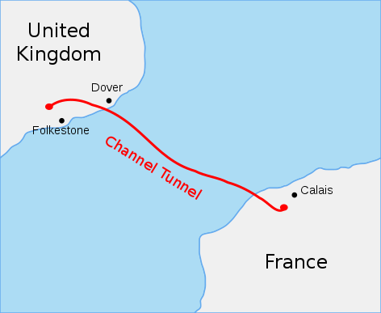
Spectacular Project Failures: CHAnnel
Example 4
The English Channel Tunnel was budgeted for in 1979 $7 billion CAD (£4 billion)
Construction began in 1988
Pilot hole complete in 1990
Opened in 1994 (one year late) for a total cost of $13 billion CAD
(£7.4 billion)

Slide 27

Spectacular Project Failures Silver Medal Winner
In March 1997 Washington State ended a project aimed at
automating the registration and license renewal process.
At that time it was 2 years late and $51.5 million over budget.
Of which $40 million was spend without result.

Slide 28
Spectacular Project Failures: Project Taurus
Example 5
Project Taurus – London Stock Exchange attempts to create a paperless share settlement system for £6 million ($10.5 million CAD) in 1983
Initial design was dropped in 1989, changed to a more complicated system purchased from the US
Very different finance laws between Britain and the US
The project is finally abandoned after 11 years and running up £792 million ($1.4 billion CAD) in costs.
(132 times the original budget)

